Slide 1
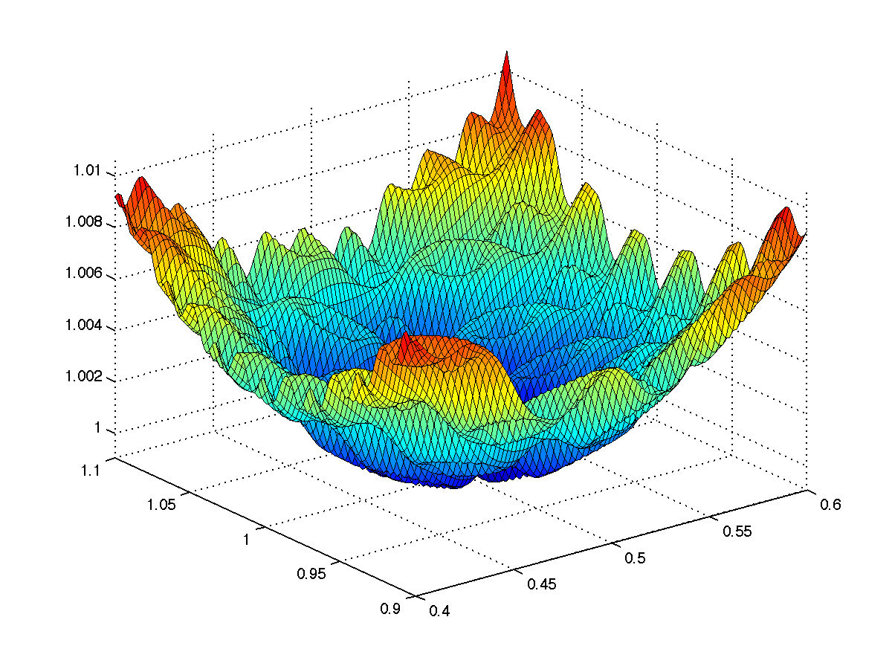
CS 5/7320 Artificial Intelligence Local Search AIMA Chapters 4.1 & 4.2
Slides by Michael Hahsler based on slides by Svetlana Lazepnik with figures from the AIMA textbook.
This work is licensed under a Creative Commons Attribution-ShareAlike 4.0 International License.

Slide 2

Recap: Uninformed and Informed Search
Tries to find the
best path
from a
given initial state
to a
given goal state.
Typically searches a large portion of the search space (needs time and memory).
Often comes with optimality guarantees.
Initial state
Goal state

Slide 3
Local Search Algorithms
Local move from state to state
What if we do not know a goal state, but how “good” different states are? This is typically called the objective function → finding the “best state” is an optimization problem.
We need a fast and memory-efficient way to find the best/a good state.
x
x
Objective function
(minimize disutility)
State space (x, y)
Idea:
Improve the current solution by moving from the current state to a neighboring better state (a.k.a. performing a local move).
This is fast and needs little memory (no search tree).

Slide 4
Local Search Algorithms
Difference to search from the previous chapter:
Goal state is unknown, but we know or can calculate the utility for each state the utility. We want to identify the state with the highest utility.
Often no explicit initial state + path to goal and path cost are not important.
No search tree. Just stores the current state and move to a “better” state if possible.
Use in AI
Goal-based agent: Identify a good goal state with a good objective function value (utility) before planning the path to that state.
Utility-based agent: Use utility as the objective function and always move to higher utility states. A greedy method used for complicated/large state spaces or online search.
General optimization: Use for effective heuristic search to find good solutions in large or continuous search spaces. E.g., gradient descend to train neural networks.

Slide 5



Example: n-Queens Problem
Goal: Put n queens on an n × n board with no two queens on the same row, column, or diagonal.
State representation: Structured storing the position of the queens.
State space: All possible n-queen configurations. How many are there?
What is a possible objective function?

Slide 6
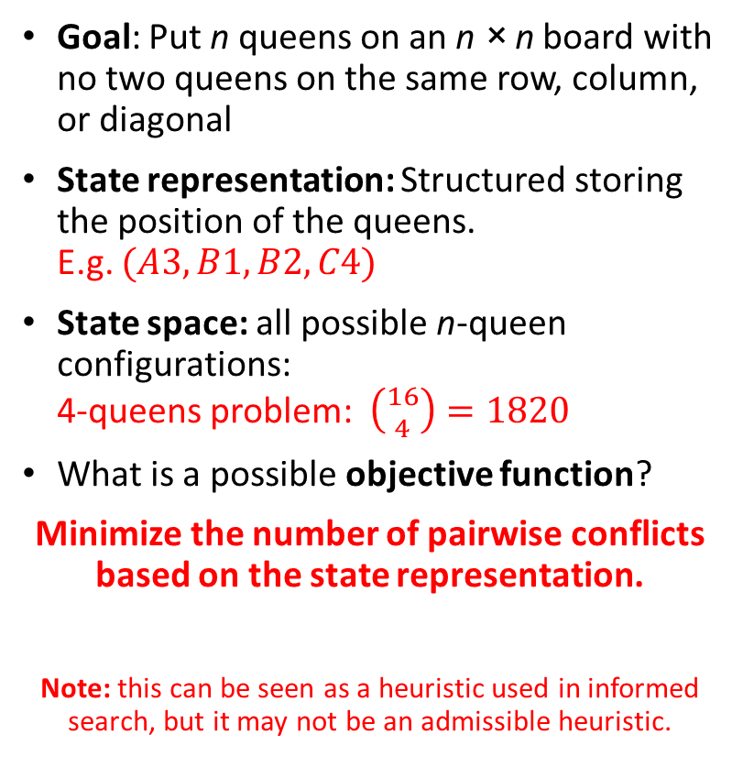
Example: n-Queens Problem
2 conflicts
1
2
3
4
Goal: Put n queens on an n × n board with no two queens on the same row, column, or diagonal
State representation: Structured storing the position of the queens. E.g. $(A3, B1, B2, C4)$
State space: all possible n-queen configurations: 4-queens problem: $\left({16 \atop 4}\right)=1820$
What is a possible objective function?
Minimize the number of pairwise conflicts based on the state representation.
Note: this can be seen as a heuristic used in informed search, but it may not be an admissible heuristic.
A B C D
0 conflicts

Slide 7
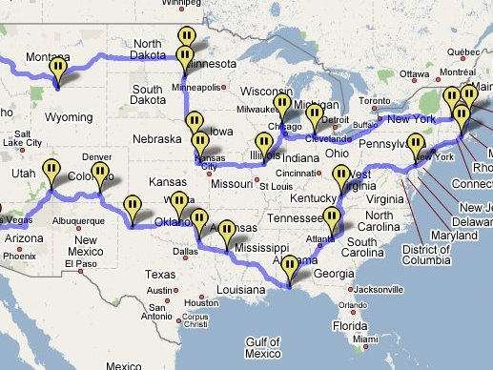
Example: Traveling salesman problem
Goal: Find the shortest tour connecting a given set of cities
State space: all possible tours (states are not individual cities!)
Objective function: minimize the length of the tour
Note: We have solved a different problem with uninformed/informed search! Each city was defined as a state and the path was the solution.

Slide 8

Hill-Climbing Search aka Greedy Local Search
Idea: keep a single “current” state and try to find better neighboring states.
MotorCycleUSA.com

Slide 9
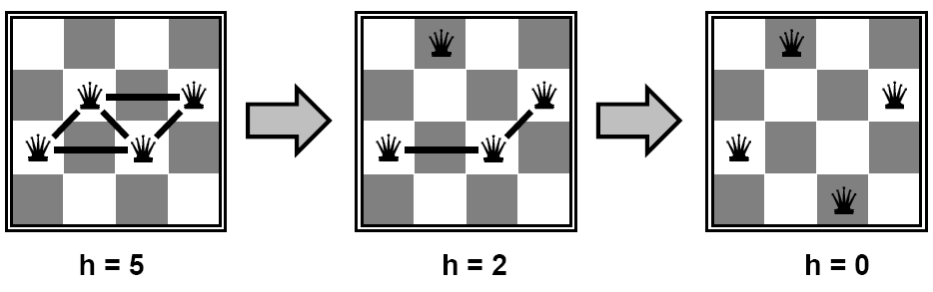
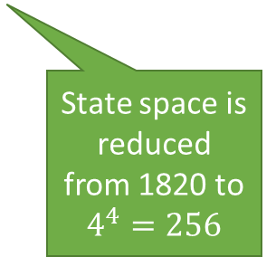
Example: n-Queens Problem
Goal: Put n queens on an n × n board with no two queens on the same row, column, or diagonal. State space: all possible n-queen configurations. We can restrict the state space: Only one queen per column.
Objective function: minimize the number of pairwise conflicts.
What is a possible local improvement strategy?
Move one queen within its column to reduce conflicts
State space is reduced from 1820 to $4^{4}=256$

Slide 10
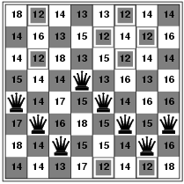
Example: n-Queens Problem
Goal: Put n queens on an n × n board with no two queens on the same row, column, or diagonal. State space: all possible n-queen configurations. We can restrict the state space: Only one queen per column.
Objective function: minimize the number of pairwise conflicts.
What is a possible local improvement strategy?
Move one queen within its column to reduce conflicts
h = 17
best local improvement has h = 12 Note that there are many options, and we have to choose one!

Slide 11
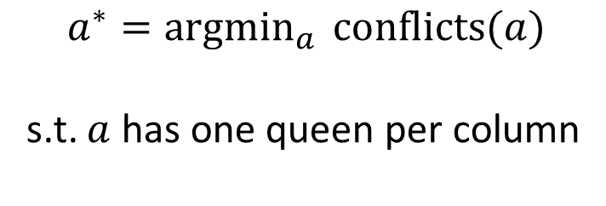
Example: n-Queens Problem
Optimization problem: find the best arrangement $a$
$$a^{∗}={argmin}_{a } conflicts(a)$$ s.t. $a$ has one queen per column
Remember: This makes the problem a lot easier.

Slide 12

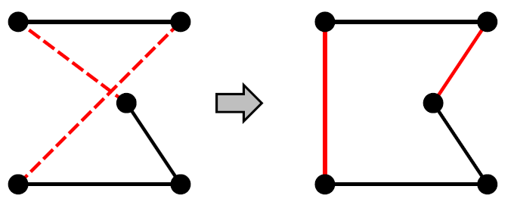
Example: Traveling Salesman Problem
Goal: Find the shortest tour connecting n cities
State representation: tour (order in which to visit the cities) = a permutation
State space: all possible tours
Objective function: length of tour
What’s a possible local improvement strategy?
Start with any complete tour, perform pairwise exchanges.
Permutation:
ABDEC
ABCED
A
B
A
B
C
C
D
E
D
E

Slide 13
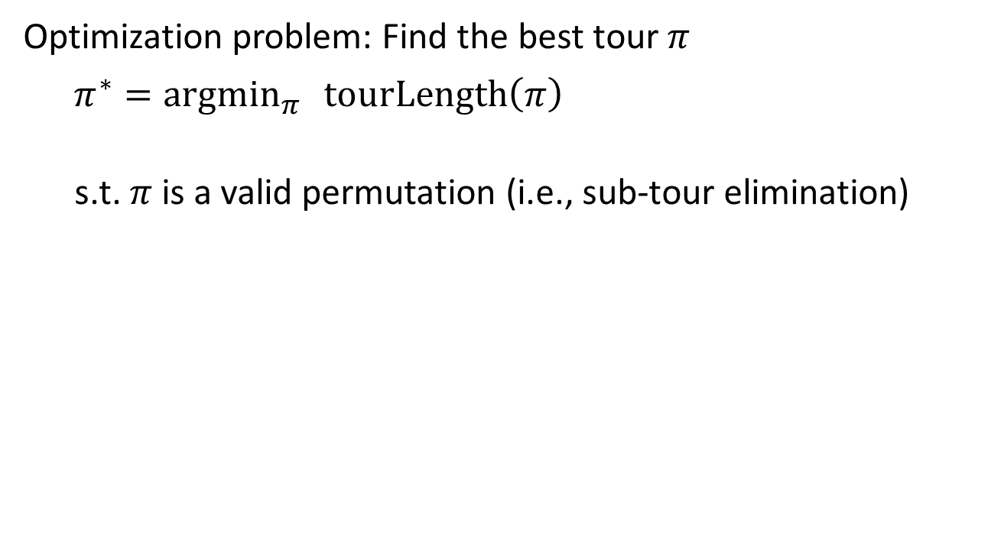
Example: Traveling Salesman Problem
Optimization problem: Find the best tour $π$
${π^{∗}=argmin}_{π } tourLength\left(π\right)$
s.t. $π$ is a valid permutation (i.e., sub-tour elimination)
Permutation:
ABDEC
ABCED
A
B
A
B
C
C
D
E
D
E

Slide 14
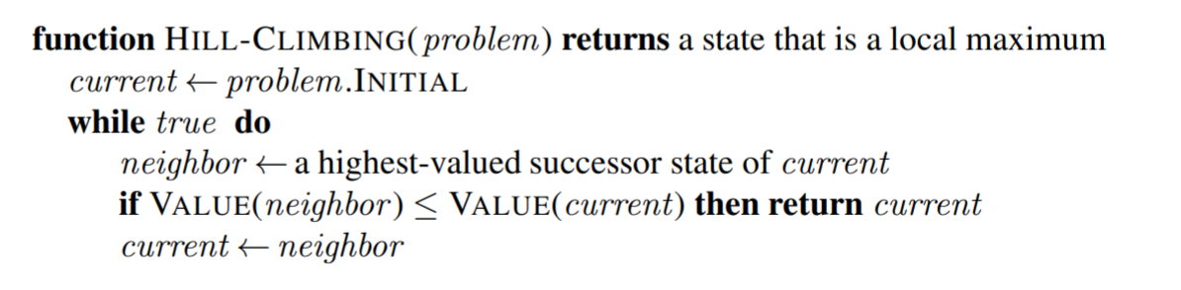
Hill-Climbing Search (= Greedy Local Search)
Typically, we start with a random state
Variants:
Steepest-ascend hill climbing
Check all possible successors and choose the highest-valued successors.
Stochastic hill climbing
choose randomly among all uphill moves, or
generate randomly one new successor at a time until a better one is found = first-choice hill climbing – the most popular variant, this is what people often mean when they say “stochastic hill climbing”
Random-restart hill climbing – to deal with local optima
Restart hill-climbing many times with random initial states and return the best solution.

Slide 15
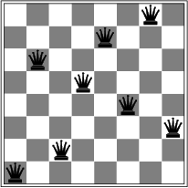
Hill-Climbing Search
Hill-climbing search is like greedy best-first search with the objective function as a (maybe not admissible) heuristic and no frontier (just stops in a dead end).
Is it complete/optimal?
No – can get stuck in local optima
Example: local optimum for the 8-queens problem. No single queen can be moved within its column to improve the objective function.
h = 1

Slide 16
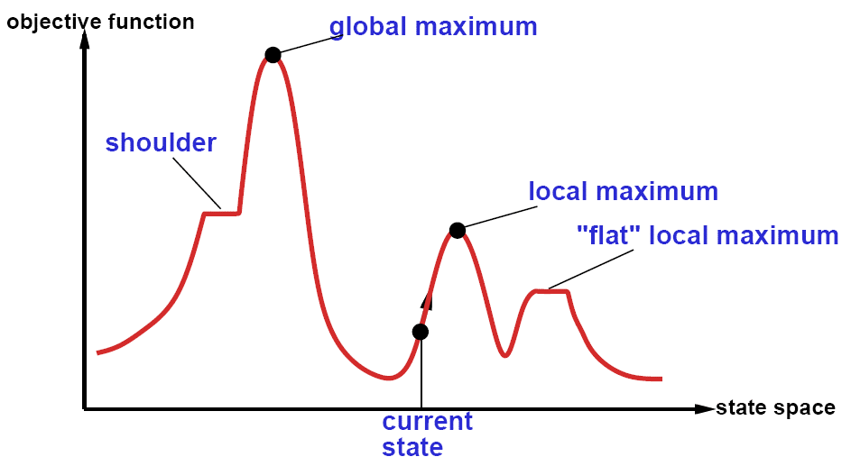
The State Space “Landscape”
We typically can calculate the utility (objective function value) from the state description.
max.
Neighbors placed next to each other
How to escape local maxima?
→ Random restart hill-climbing can help.
What about “shoulders” (called “ridges” in higher dimensional space)?
What about “plateaus”?
→ Hill-climbing with sideways moves.

Slide 17
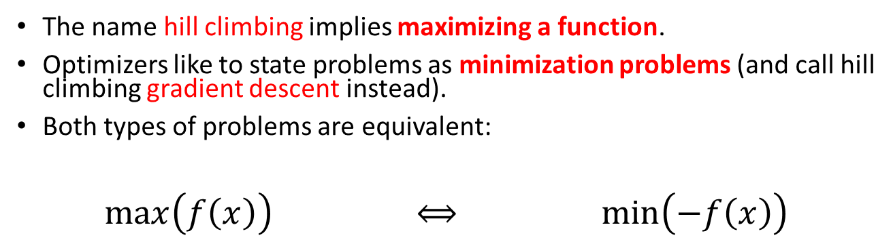
Minimization vs. Maximization
The name hill climbing implies maximizing a function.
Optimizers like to state problems as minimization problems (and call hill climbing gradient descent instead).
Both types of problems are equivalent:
$\max\left(f\left(x\right)\right)$ $⟺$ $\min\left(−f\left(x\right)\right)$

Slide 18
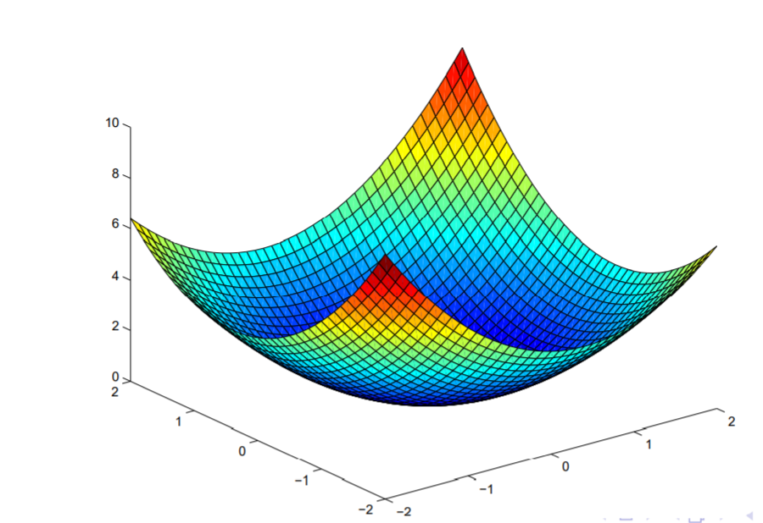
Convex vs. Non-Convex Optimization Problems
Minimization problems
Convex Problem
Non-convex Problem
One global optimum + smooth function → calculus makes it easy
Many local optima → hard
Many discrete optimization problems are like this.

Slide 19
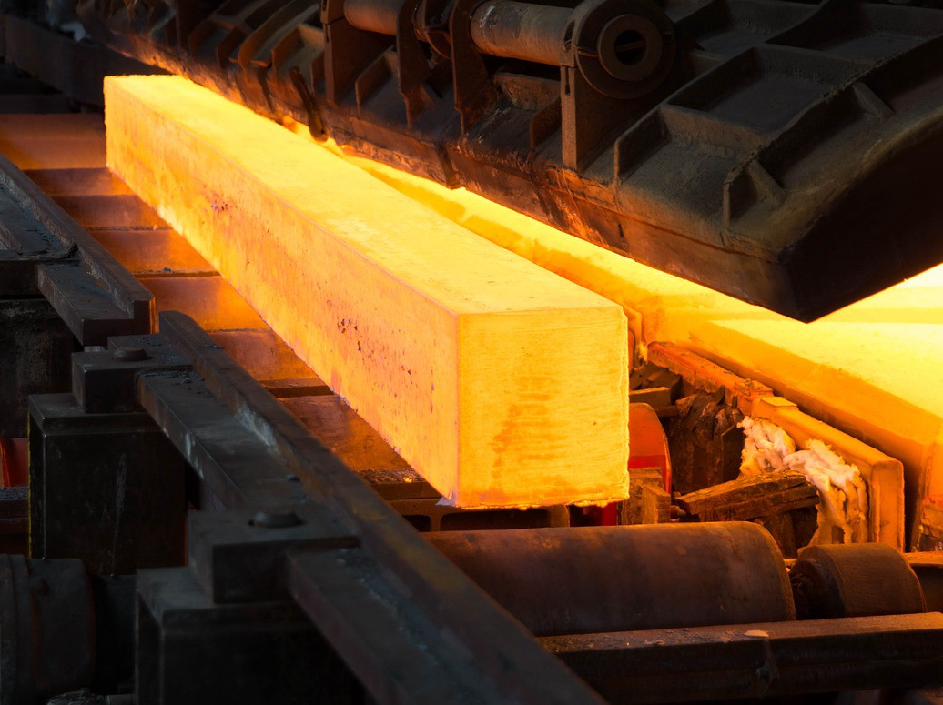
Simulated Annealing
Use heat to escape local optima…

Slide 20
Simulated Annealing
Idea: First-choice stochastic hill climbing + escape local minima by allowing some “bad” moves but gradually decrease their frequency.
Inspired by the process of tempering or hardening metals by decreasing the temperature (chance of accepting bad moves) gradually.
“bad” local move
Objective function (minimize)
State space

Slide 21
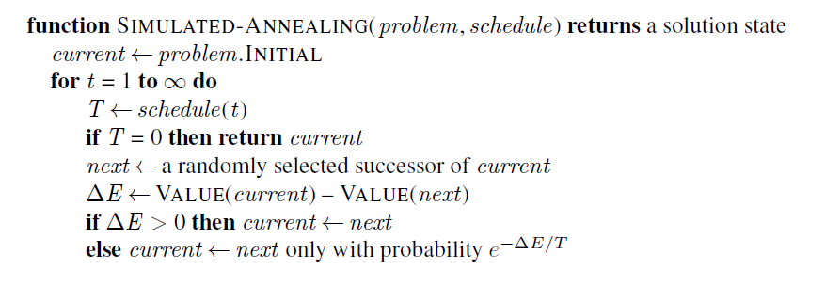
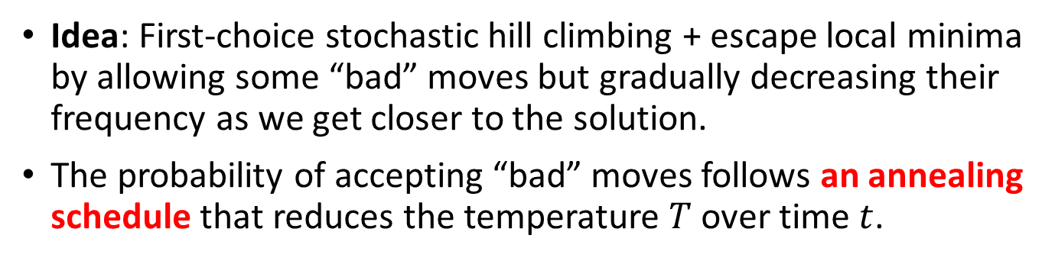
Simulated Annealing
Idea: First-choice stochastic hill climbing + escape local minima by allowing some “bad” moves but gradually decreasing their frequency as we get closer to the solution.
The probability of accepting “bad” moves follows an annealing schedule that reduces the temperature $T$ over time $t$.
Typically, we start with a random state
VALUE(next) – Value(current)
Always do good moves
Uses the Metropolis acceptance criterion to accept “bad” moves
Note: Use VALUE(current) – VALUE(next) for minimization

Slide 22
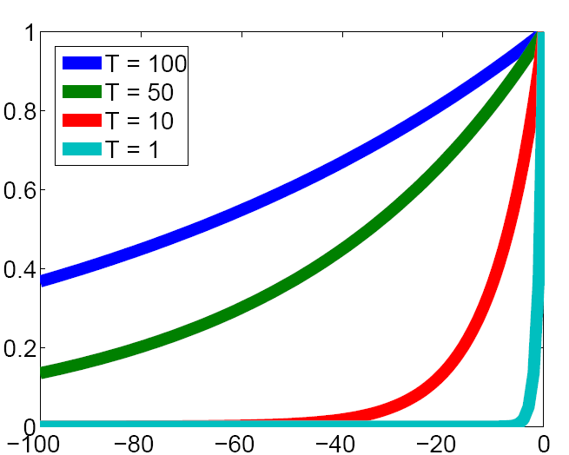
The Effect of Temperature
Prob. of accepting a worse state exp(ΔE/T)
ΔE (neg. means the solution gets worse)
The lower the temperature, the less likely the algorithm will accept a worse state.

Slide 23
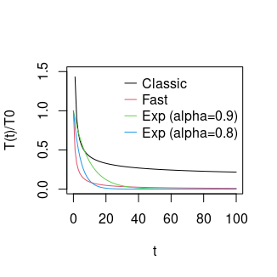
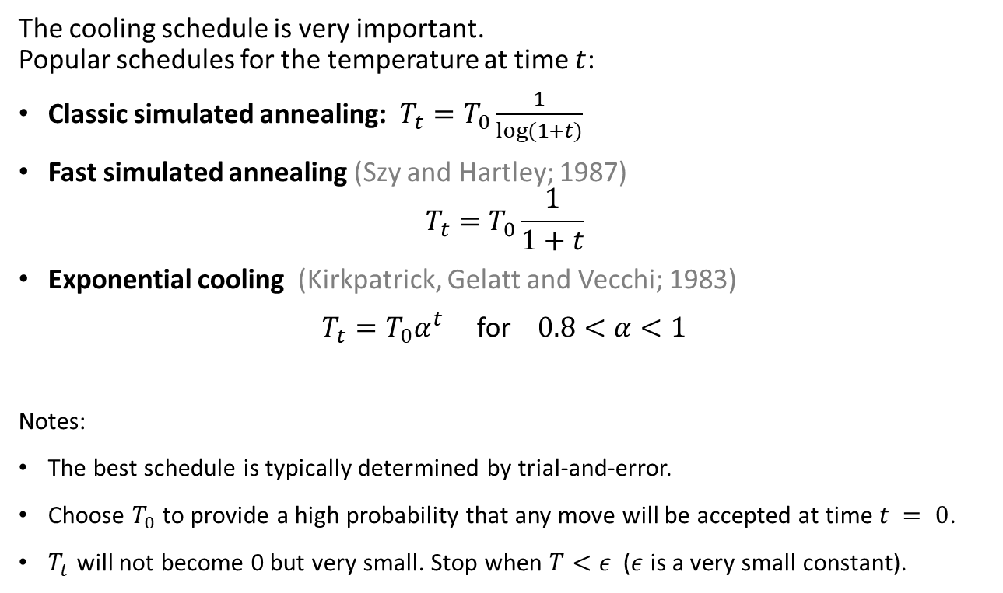
Cooling Schedule
The cooling schedule is very important. Popular schedules for the temperature at time $t$:
Classic simulated annealing: $T_{t}=T_{0}\frac{1}{log⁡(1+t)}$
Fast simulated annealing (Szy and Hartley; 1987)
$$T_{t}=T_{0}\frac{1}{1+t}$$
Exponential cooling (Kirkpatrick, Gelatt and Vecchi; 1983)
$T_{t}=T_{0}α^{t}$ for $0.8<α<1$
Notes:
The best schedule is typically determined by trial-and-error.
Choose $T_{0}$ to provide a high probability that any move will be accepted at time $t = 0$.
$T_{t}$ will not become 0 but very small. Stop when $T<ε$ ($ε$ is a very small constant).

Slide 24
Simulated Annealing Search
Guarantee: If temperature decreases slowly enough, then simulated annealing search will find a global optimum with probability approaching one.
However:
This usually takes impractically long.
The more downhill/uphill steps you need to escape a local optimum, the less likely you are to make all of them in a row.
The related Markov Chain Monte Carlo (MCMC) method is a general family of randomized algorithms for exploring complicated state spaces.

Slide 25
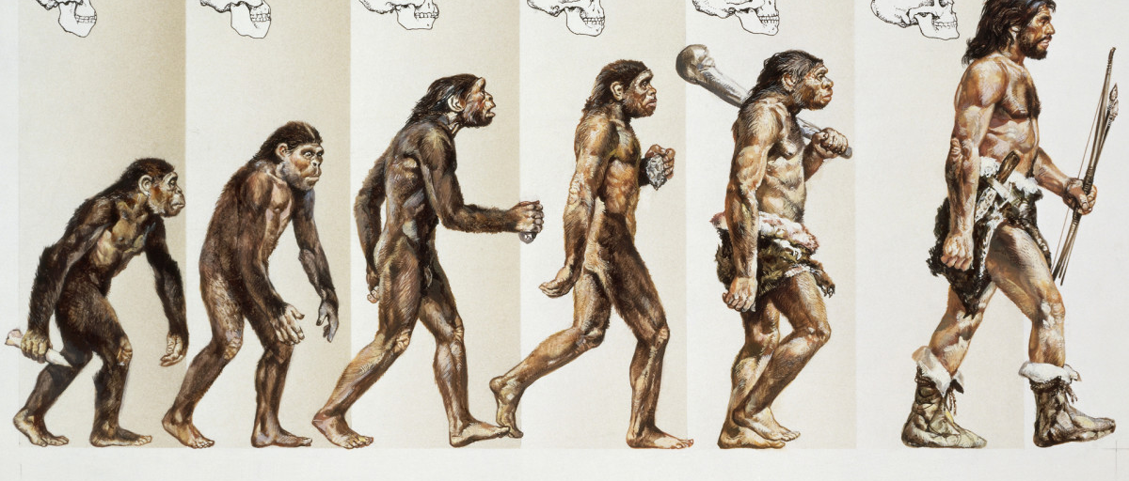
Evolutionary Algorithms
A Population-based Metaheuristics

Slide 26
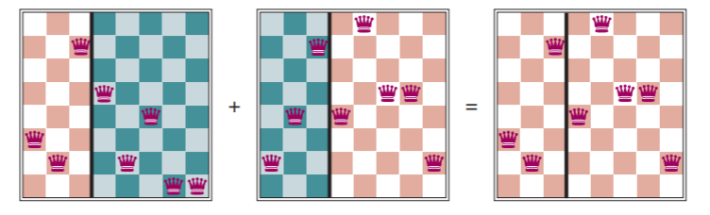
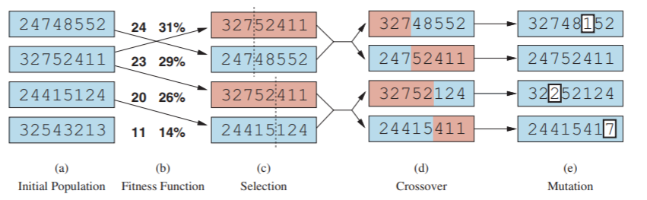
Evolutionary Algorithms / Genetic Algorithms
A metaheuristic for population-based optimization.
Uses mechanisms inspired by biological evolution (genetics):
Reproduction: Random selection with probability based on a fitness function.
Random recombination (crossover)
Random mutation
Repeated for many generations
Example: 8-queens problem
8
7
6
5
4
3
2
1
Individual = state representation as a chromosome: row of the queen in each column
next generation

Slide 27
Search in Continuous Spaces

Slide 28


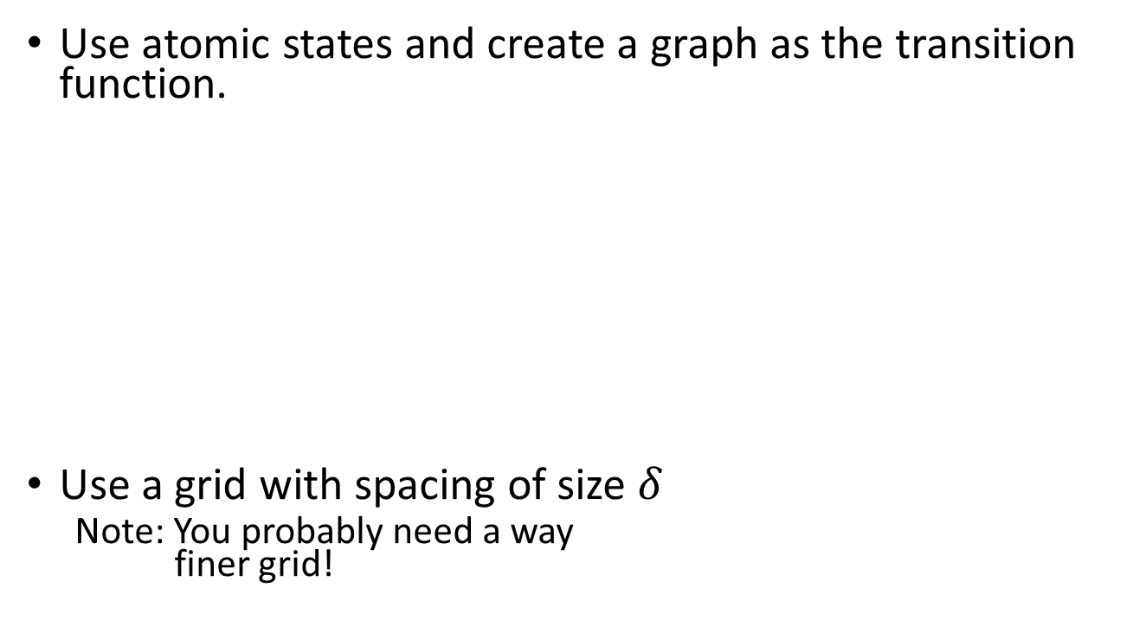
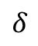
Discretization of Continuous Space
Use atomic states and create a graph as the transition function.
Use a grid with spacing of size $δ$
Note: You probably need a way finer grid!
$$δ$$
y
x

Slide 29
Discretization of Continuous Space
How did we discretize this space?
Initial state
Goal state

Slide 30
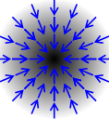
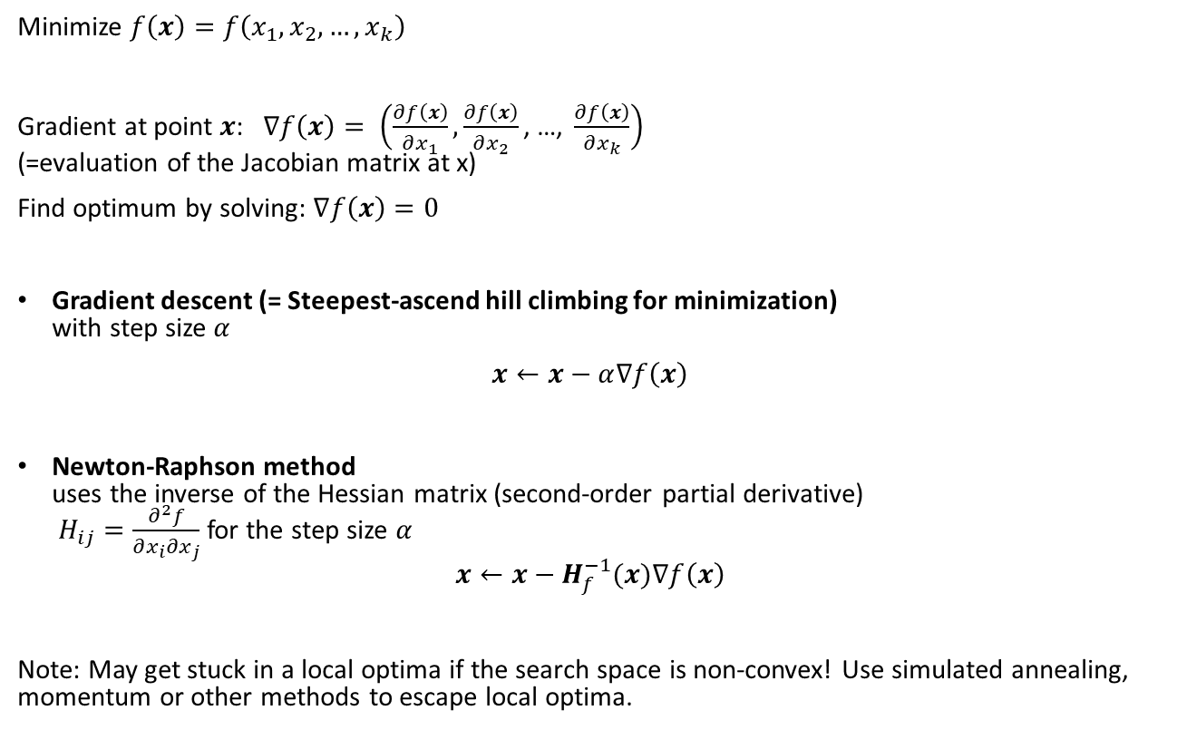
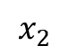
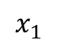
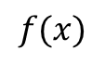
Search in Continuous Spaces: Gradient
$$f(x)$$
Minimize $f\left(x\right)=f\left(x_{1},x_{2},…,x_{k}\right)$
Gradient at point $x$: $∇f\left(x\right)= \left(\frac{∂f\left(x\right)}{∂x_{1}}, \frac{∂f\left(x\right)}{∂x_{2}}\text{, …, }\frac{∂f\left(x\right)}{∂x_{k}}\right)$ (=evaluation of the Jacobian matrix at x)
Find optimum by solving: $∇f\left(x\right)=0$
Gradient descent (= Steepest-ascend hill climbing for minimization) with step size $α$
$x←x−α∇f\left(x\right)$
Newton-Raphson method uses the inverse of the Hessian matrix (second-order partial derivative) $H_{ij}=\frac{∂^{2}f}{∂x_{i}∂x_{j}}$ for the step size $α$
$$x←x−H_{f}^{−1}(x)∇f\left(x\right)$$
Note: May get stuck in a local optima if the search space is non-convex! Use simulated annealing, momentum or other methods to escape local optima.
$$x_{1}$$
$$x_{2}$$

Slide 31
Search in Continuous Spaces: Empirical Gradient Methods
What if the mathematical formulation of the objective function is not known?
We may have objective values at fixed points, called the training data.
In this case, we can use empirical gradient search. This is related to steepest ascend hill climbing in the discretized state space.
→ We will talk more about search in continuous spaces with loss functions using gradient descend when we talk about parameter learning for machine learning.

